Slide 1

Electrostatic Sensors
Student’s Name
Institutional Affiliation
Course
Date

Slide 2

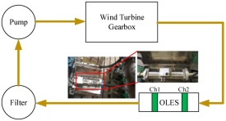
Electrostatic Sensors
Introduction
Selected article is Electrostatic Sensor Application for On-Line Monitoring of Wind Turbine Gearboxes by Huijie Mao, Hongfu Zuo, and Han Wang
Online technology is used for monitoring wear and tear that has been approved in the laboratories
The technology measures wear and tear is based on electrostatic induction principles.
The system can be described as debris recognition technique.
The above article investigates the potential of the technique in its application.
Currently the utility of the technique is unclear.

Slide 3

Electrostatic Sensors
Analysis
The article focuses on the use of on-line electrostatic sensors as a recent technology in wind turbine gearboxes to monitor wear and tear.
The technology will reduce the cost of maintenance of the wind turbines thus increase the competitiveness of wind energy.
Electrostatic sensors measure wear and teat in the gearboxes thus eliminating shutdown for inspections.
These shutdowns are expensive and some times make wind energy unreliable.
They also help avoid costly machine failures.

Slide 4
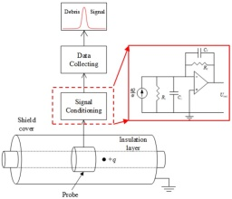
Electrostatic Sensors
The online electrostatic sensor (OLES) works as a full flow electrostatic inducing device.
The electrostatic sensor is mounted alongside the lubrication system.
The sensor comprises of; inner insulating tube, a probe and a shied.
Grounding of the shield is done to guard the sensor from external electrostatic fields.
The probe acts as a sensor and its attached to the signal conditioning unit knows as a charge amplification circuit turning charge into voltage signals using the principle below U out=−Q/ C f

Slide 5

Electrostatic Sensors
Ethical global and societal impact of electrostatic
There are no concerns about the application of electrostatic sensors to measure the wear and tear in wind turbine engines.
The sensors are not harmful to human beings and their use doesnot affect the environment in any way.
They however need to be installed by qualified personnel for effective working.
The application of the technology has not been intensified. With its intensification maybe concerns will be noted.

Slide 6
Electrostatic Sensors
Future projections
The application of the technology will highly increase competitiveness of wing energy.
The increased competiiven3ess will be as a result of cheap maintenance costs and reliability of wind energy.
In future wind energy will be cheaper than other forms of energy such as petroleum and hydro-generated energy.
By removing shutdown for repair situations the reliability of wind energy will increase highly.
The online electrostatic sensors’ uses will advance to revolutionize other fields in energy production.

Slide 7
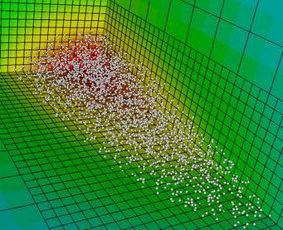
Electrostatic Sensors
Summary
The use of electrostatic sensors enables engineer access the process of wear and tear in wind turbines.
The technology can also be used for particle sizing in particle conveyors.
The technology applies in measurement of particles within a range of few millimeters.
Electrostatic sensors will revolutionize wind energy production
Electrostatic sensors have been approved as reliable.

Slide 8
Electrostatic Sensors
Conclusion
Using debris recognition technology, the electrostatic sensors effectively capture the debris characteristic pulse thus showing the conditions of the gearbox.
The amplitude of debris recognition signal indicated increase over time showing engineers when the gearboxes need repair.
The electrostatic sensors are not affected by the temperature of oil in the gearbox this makes the applicability strong.
The article concludes that the electrostatic sensors are effective in monitoring wear and tear of gearboxes in wind turbines.

Slide 9
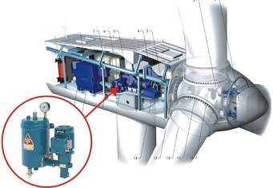
Electrostatic Sensors
Reference
Mao, H., Zuo, H., & Wang, H. (2018). Electrostatic Sensor Application for On-Line Monitoring of Wind Turbine Gearboxes. Sensors (Basel, Switzerland), 18(10), 3574. https://doi.org/10.3390/s18103574

